Slide 1
Mathematical Foundations for Machine Learning
MFML Team

Slide 2
S2 -22 AIMLCZC416, MFML
Webinar#1

Slide 3
Agenda
Discussion on Solutions of
Homework Problems
Proof

Slide 4
Homework Problem
Q1 Let A_{m×n} be a given matrix with m > n. If the time taken to compute the determinant of a square matrix of size j is j³, find upper bound on the
total time taken to find the rank of A using determinants
number of additions and multiplications required to determine the rank using the elimination procedure.

Slide 5
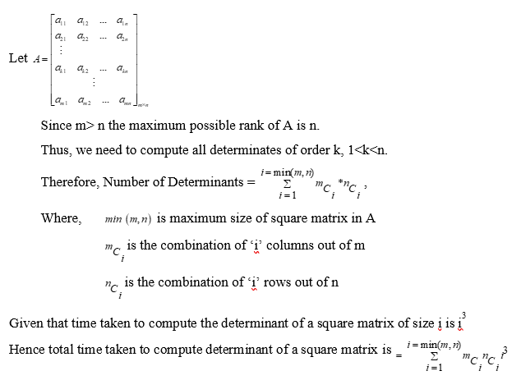
Homework Problem
total time taken to find the rank of A using determinants
Answer to be inserted

Slide 6
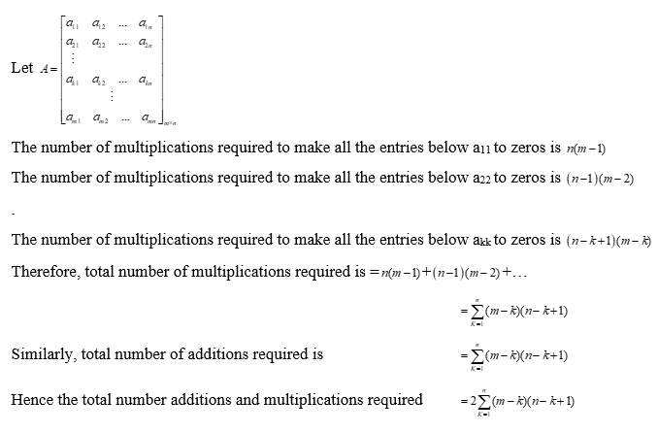
Homework Problem
number of additions and multiplications required to determine the rank using the elimination procedure.
Solution:

Slide 7
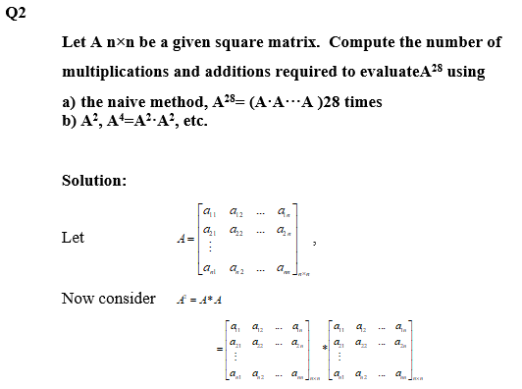
Homework Problem

Slide 8
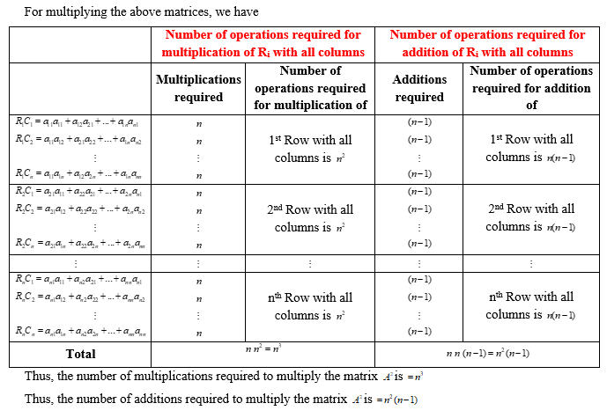
Homework Problem

Slide 9
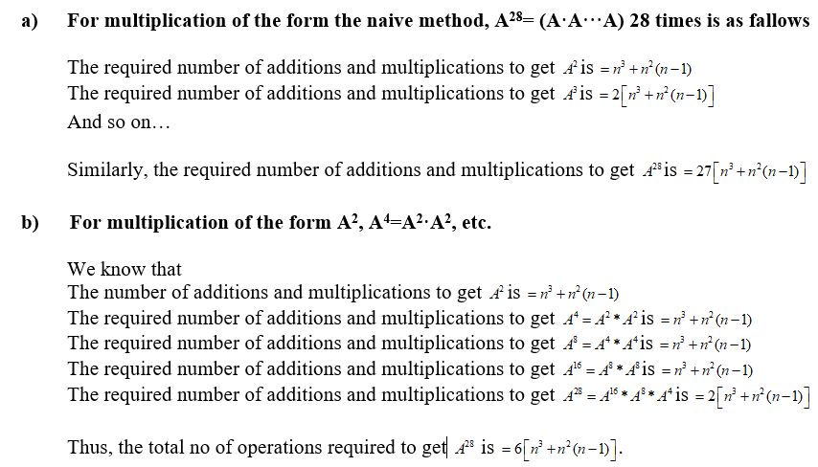
Homework Problem

Slide 10
Homework Problem
Q3: Let A_{nxk} and B_{kxk} be two given matrices with
rank(B) =k. Estimate the rank of AB in terms of the ranks of
A and B. Note that the rank of a matrix is the dimension of
the vector space spanned by its rows/ columns.
Consider the spaces
C₁ ={Ax : x is a vector of length k}
C₂ ={ABy : y is a vector of length k}
C₁ and C₂ are vector spaces. Let y be any vector of length
k and x = By. Since ABy = Ax belongs to C₁
C₂ is a subspace of C₁
dim(C2) ≤ dim(C1)
rank (AB) ≤ rank(A)

Slide 11
Homework Problem
Applying to the transpose
rank(AB)^{t} = rank(B^{t}A^{t}) ≤ rank(B^{t}) = rank(B)
Rank (AB) ≤ rank(B)
Thus
rank(AB) ≤ min{rank(A), rank(B)}

Slide 12
Homework Problem
Q4: Compute the total number of divisions, multiplications and additions required to perform the forward elimination and back substitution in solving a system of linear equations A_{nxn} x = b using the Gauss elimination method.

Slide 13
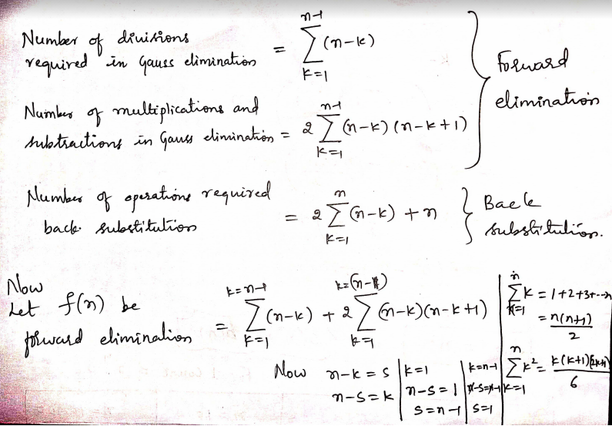
Homework Problem

Slide 14
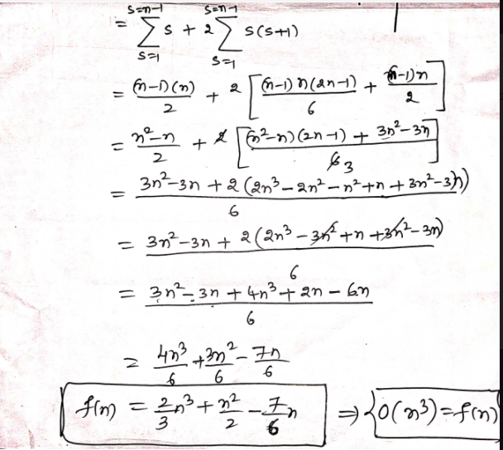
Homework Problem

Slide 15
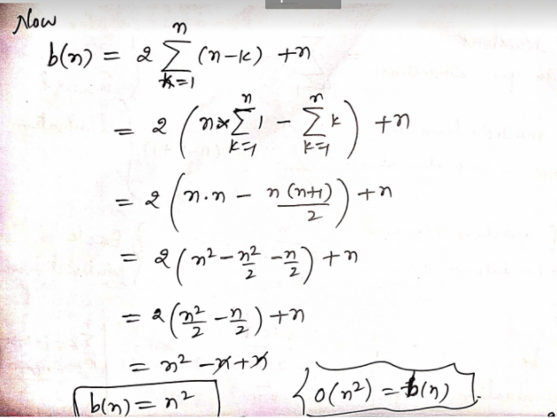
Homework Problem

Slide 16
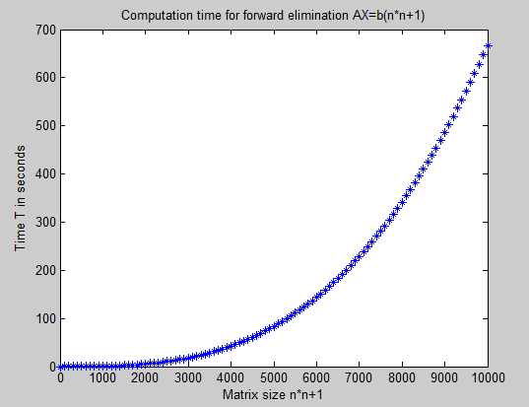
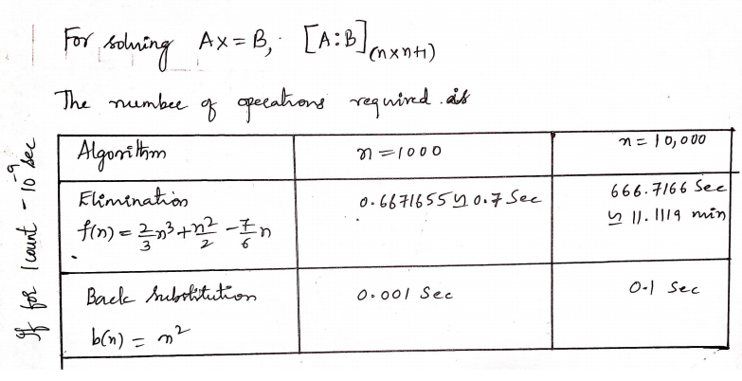
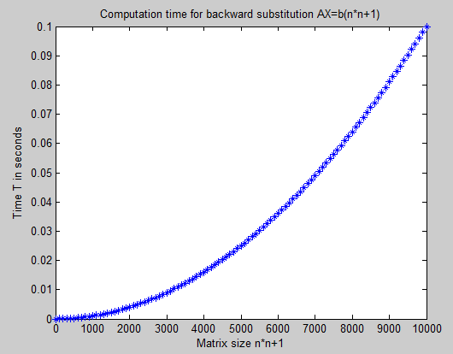
Homework Problem
N=0:100:10000;
f=(2/3)*(N.^3)+(1/2)*(N.^2)-(7/6)*(N);
%f=(N.^2); for backward sub
T=f*10^(-9);
plot(N,T,'*')

Slide 17
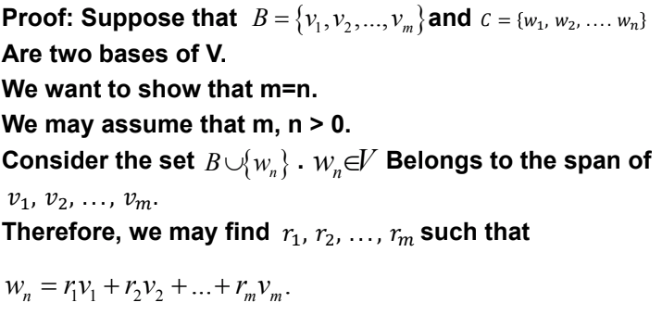
Theorem: Let V be a finite dimensional vector space. Then any two bases have the same cardinality.

Slide 18
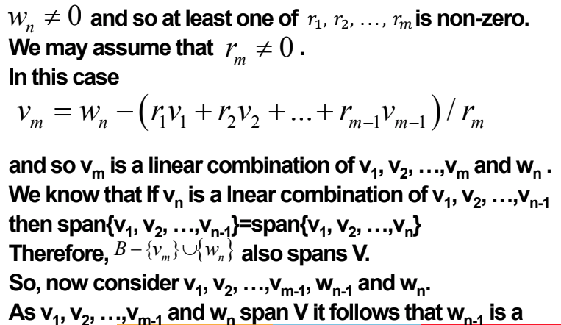
Theorem: Let V be a finite dimensional vector space. Then any two bases have the same cardinality.

Slide 19
Theorem: Let V be a finite dimensional vector space. Then any two bases have the same cardinality.
linear combination of v₁, v₂, …,v_{m-1} and w_{n}.
Suppose that every r_{i} = 0. Then w_{n-1} and w_{n} are dependent,
which contradicts the fact that C is a basis. Thus r_{i} ≠ 0
some i. Relabelling we may suppose that r_{m-1} ≠ 0. As before
this implies that v_{m-1} is a linear combination of v₁, v₂,
…,v_{m-2}, w_{n-1} and w_{n}. But from the known results v₁, v₂,
…,v_{m-1}, w_{n-1} and w_{n} span V.
We can repeat this process for every vector in C. It follows
that m ≤ m. By symmetry n ≤ m. But then m=n.

Slide 20
Product of any two lower triangular matrices
is a lower triangular matrix
A=[a_{n}], B=[b_{n}] be lower triangular matrices of order n and let C=AB
The diagonal elements of C are given by
(ii) The matrix C is itself lower triangular matrix
Proof: From the definition of matrix product, we have
Now both A and B are lower triangular matrices

Slide 21
Product of any two lower triangular matrices
is a lower triangular matrix
Thus:
Now if i <j, it follows that either a_{ik} or b_{kj} is zero for all k,
and thus c_{ij} = 0.
Therefore, C is also a lower triangular matrix.

Slide 22
Thank You

